Slide 1
Fundamentals of Programming
Loops

Slide 2
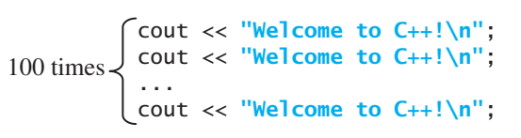
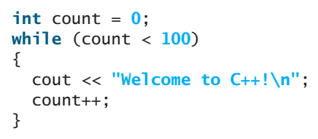
Loops
tell a program to execute statements repeatedly.
Write a program to print “Welcome to C++” 100 times.

Slide 3
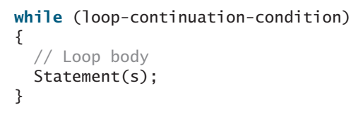
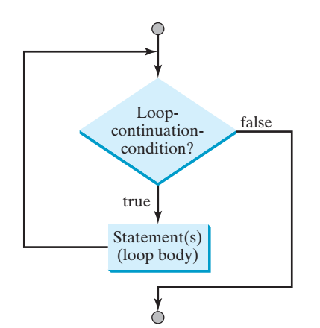
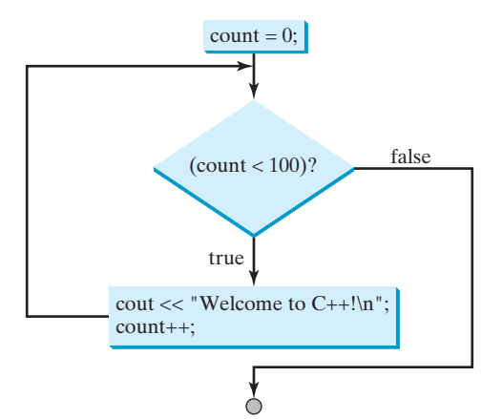
While Loop
A while loop executes statements repeatedly while the condition is true.

Slide 4
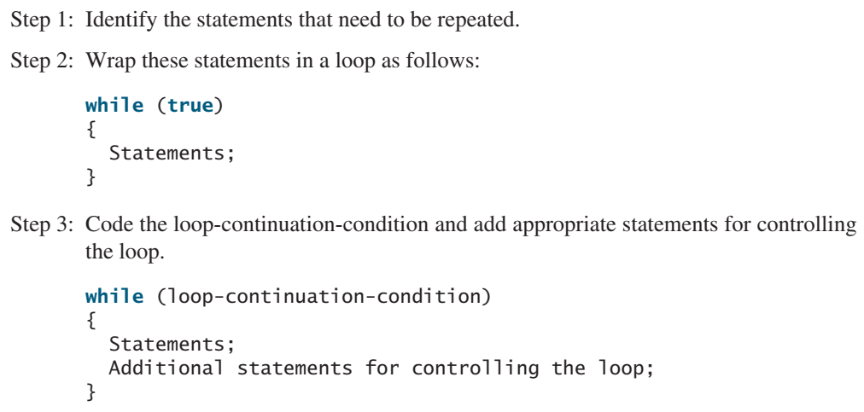
Loop Design Strategies

Slide 5
While Loop
Print numbers from 0 to 100
Print numbers from 250 to 350
ask user for a and b, and print all numbers from a to b
Write table of a number x from 1 to 10.
Print Sum of numbers from 0 to 100
Print even numbers from 0 to 100
Print Sum of even numbers from 0 to 100
Print factors of a number
Print count of numbers divisible by 3 between 0 and 100

Slide 6
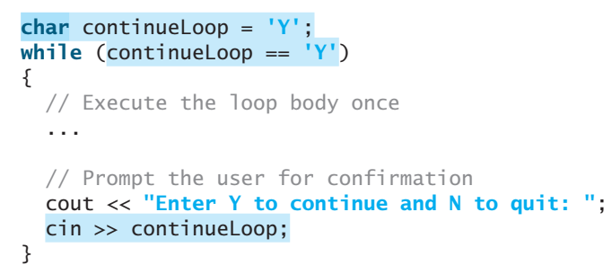
Controlling a Loop with User Confirmation

Slide 7
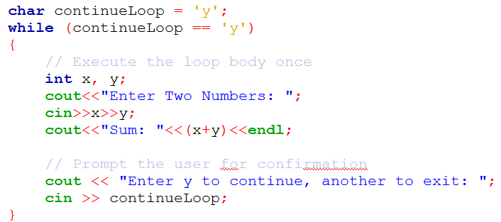
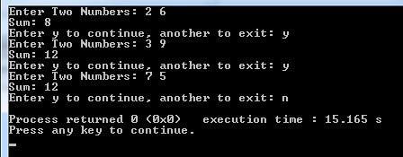
Controlling a Loop with User Confirmation

Slide 8
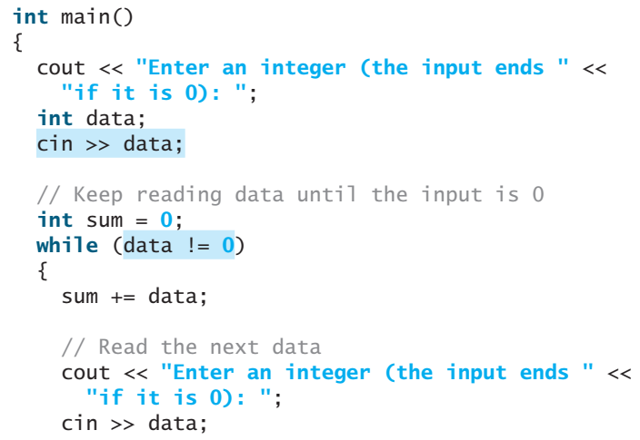
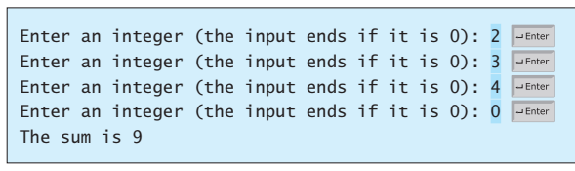
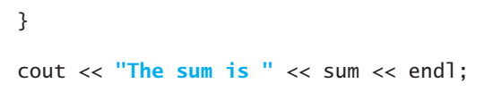
Controlling a Loop with a Sentinel Value

Slide 9
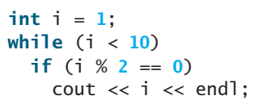
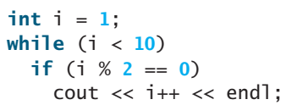
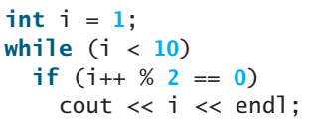
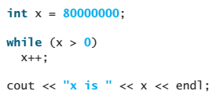
While Loop
Output?

Slide 10
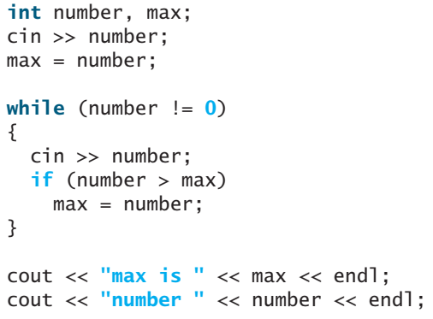
While Loop
Output of the following if input is 2 3 5 4 0

Slide 11
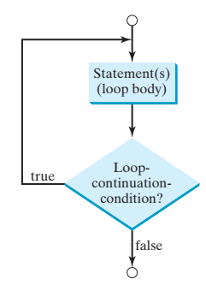
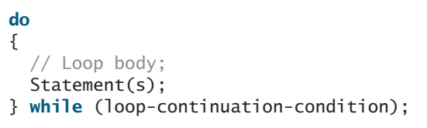
do-while Loop
A do-while loop is the same as a while loop except that it executes the loop body first and then checks the loop continuation condition

Slide 12
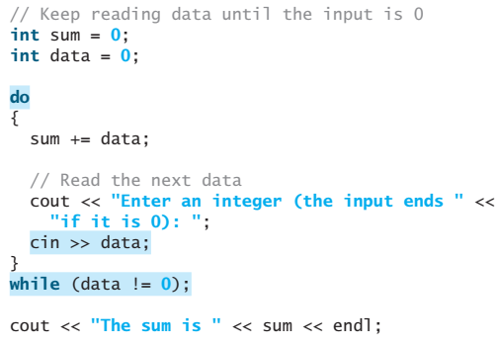
do-while Loop

Slide 13
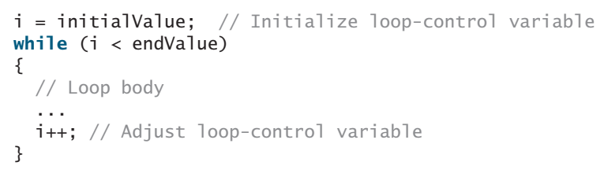
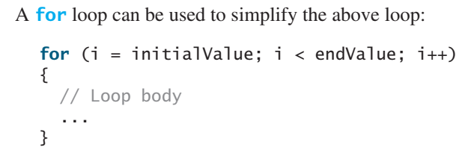
for Loop
A for loop has a concise syntax for writing loops

Slide 14
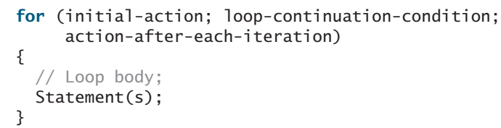
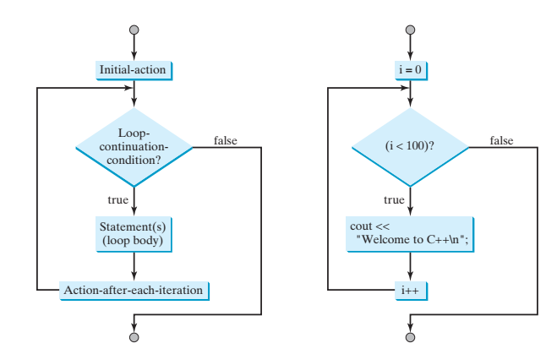
for Loop

Slide 15
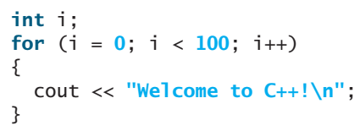
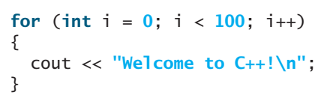
for Loop

Slide 16
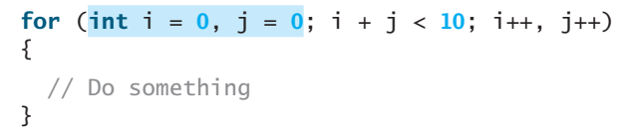
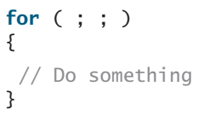
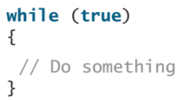
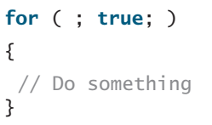
for Loop
The initial-action and action-after-each-iteration in a for loop can be a list of zero or more comma-separated variable declaration statements or assignment expression

Slide 17
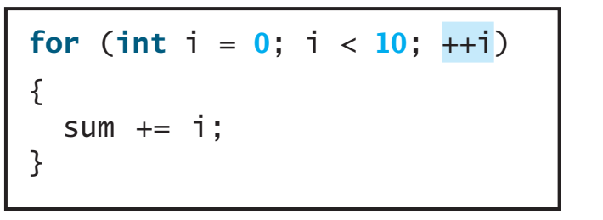
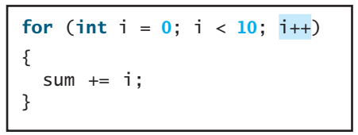
for Loop
Same output?

Slide 18
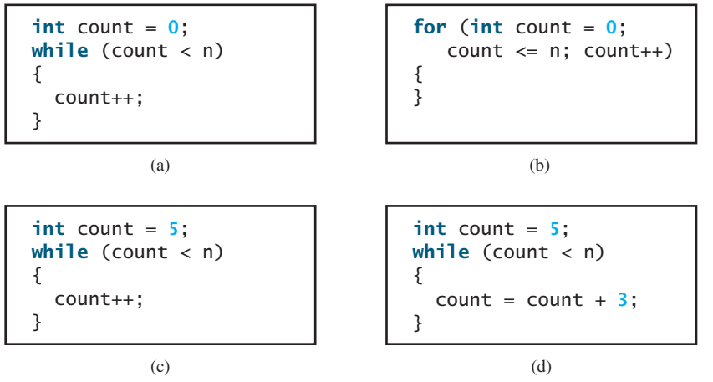
for Loop
Number of Iterations?

Slide 19
Which Loop to Use?
The while loop and for loop are called pretest loops because the continuation condition is checked before the loop body is executed.
The do-while loop is called a posttest loop because the condition is checked after the loop body is executed.
The three forms of loop statements—while, do-while, and for—are expressively equivalent; that is, you can write a loop in any of these three forms

Slide 20
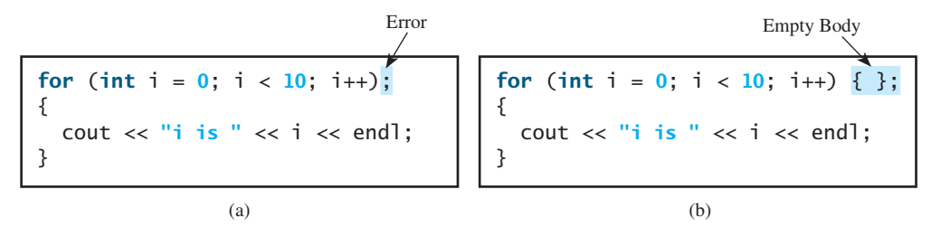
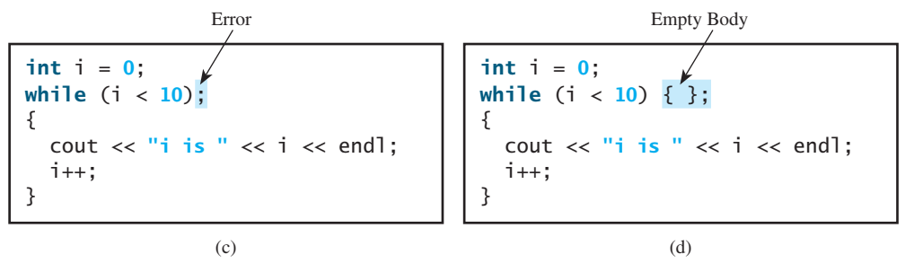
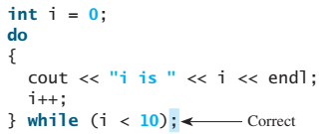
Empty Loop

Slide 21
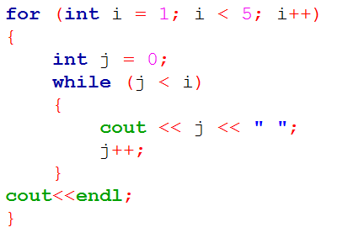
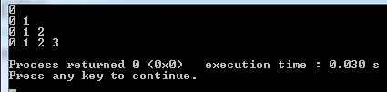
Nested Loops
A loop can be nested inside another loop.

Slide 22
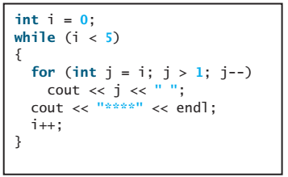
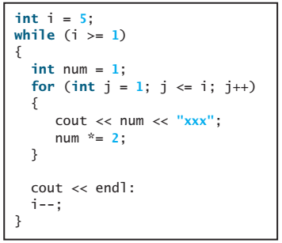
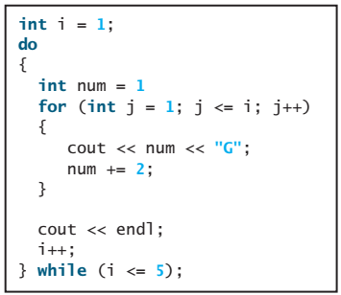
Nested Loops

Slide 23
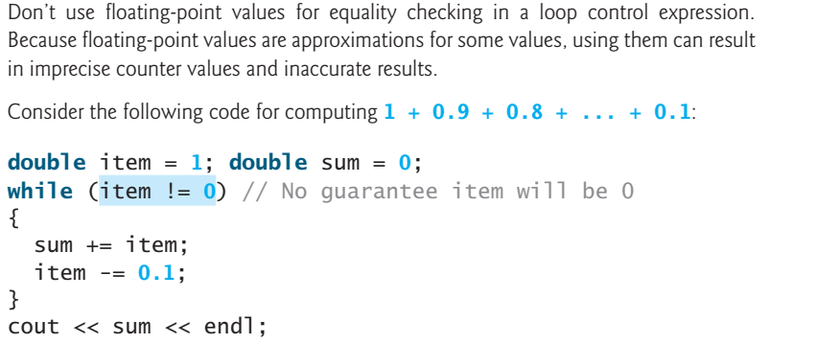
Minimizing Numeric Errors

Slide 24
Case Studies – Section 5.8, 10, 11
Finding the Greatest Common Divisor
Suppose that the tuition for a university is $10,000 this year and tuition increases 4% every year. In how many years will the tuition be doubled?
Converting Decimals to Hexadecimals
Checking Palindromes
Check whether a string is a palindrome
Displaying Prime Numbers
displays the first 50 prime numbers

Slide 25
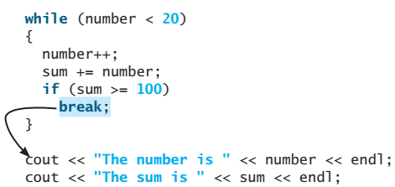
Keywords break and continue
The break and continue keywords provide additional controls in a loop
break in a loop, immediately terminates the loop
The program adds integers from 1 to 20 in this order to sum until sum is greater than or equal to 100.

Slide 26
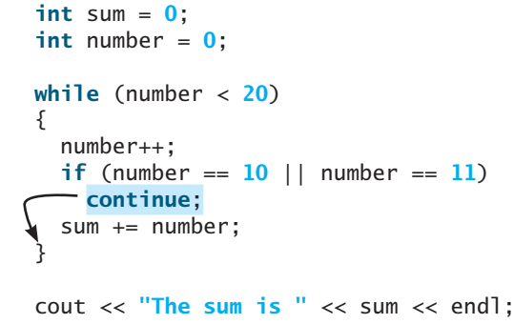
Keywords break and continue
continue in a loop, ends the current iteration. Program control goes to the end of the loop body.

Slide 27
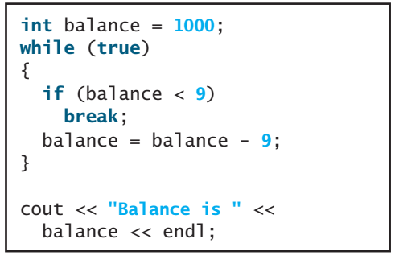
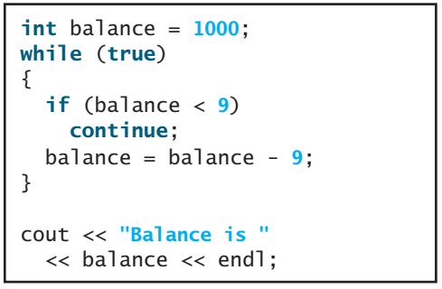
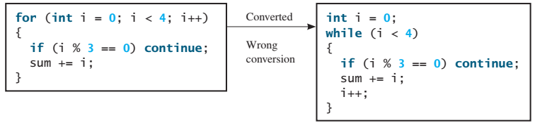
Keywords break and continue

Slide 28
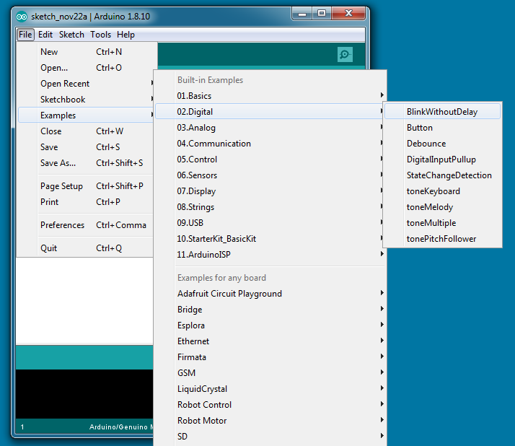

Slide 29
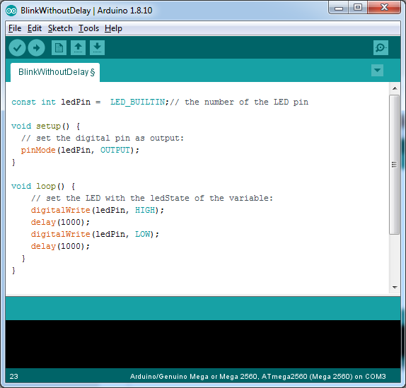

Slide 30
Thanks

